Slide 1
Hackathon 2024: HACKTIVATORS

Slide 2



Team Name and Members
JIBIN C BABY(Team Lead) - S8 CSE
Technical Interest - AI/ML , NLP , Web Development.
Project Completed – Personal Assistance for Blind using AI.
FIDHA P HARIS(Data/ML Engineer) - S8 CSE
Technical Interest – Web Development.
Project Completed – Football Live Score and Win Prediction Website, Descriptive Captions for Images using Deep Learning.
ANURUDH DEEPAN(Software Engineer) - S8 CSE
Technical Interest – AI/ML, Web Development
Project Completed – Personal Assistance for Blind using AI.

Slide 3


Team Name and Members
BADUSH(Documentation/Presentation) – S8 CSE
Technical Interest – Web Development.
Project Completed – Descriptive Captions for Images using Deep Learning, Security System for Web Page using Augmented Reality.
JESWIN JAISON – S6 CSE
Technical Interest – Programming, Software Development
Project Completed – Authenticated Access using ANPR technology.

Slide 4
LLM Problem Statement: Why
AUTOMATED CUSTOMER INTERACTION AND ORDERING SYSTEM
Manual customer interaction and order processing systems are prone to errors, delays, and inefficiencies.
Manual processes struggle to handle increasing volumes of inquiries and orders efficiently as businesses grow.
This can result in missed sales opportunities, and decreased productivity for businesses.

Slide 5
LLM Problem Statement: Why
An automated customer interaction and ordering system can provide a competitive advantage by improving efficiency and enhancing the customer experience.
It have the potential to collect and analyze vast amounts of customer data, providing valuable insights into customer preferences, behavior, and trends.
Automated systems is not just a matter of convenience but a strategic imperative for long-term success and sustainability.

Slide 6
LLM Business Problem: What
Instagram has become a good source for online brands to showcase their products.
Existing customer interaction and ordering processes are manual, leading to inefficiencies and errors.
Manual processes struggle to scale effectively to handle increasing volumes of customer inquiries and orders.
Ineffective processes may lead to missed revenue opportunities as customers abandon purchases due to delays or unsatisfactory service.

Slide 7
Solution Overview: How
Integration of Automation Technologies and API:
Instagram API is to automate Instagram.
We used instagrapi to automate Instagram.
Utilize AI and NLP for automated customer interactions.
We used zero shot classification classifier for categorizing queries.
Personalize responses to inquiries and orders efficiently.
Seamless Order Management:
Develop a centralized system for order processing and fulfillment.
Minimize errors and delays in order handling.

Slide 8
Solution Overview: How
Scalability and Flexibility:
Ensure that the system can scale seamlessly to accommodate growing customer demands and adapt to evolving business needs.

Slide 9
Economic Logic
Cost Savings:
Reduction in labor costs through automation.
Minimization of errors leading to cost savings.
Increased Productivity:
Higher throughput of customer inquiries and orders.
Ability to serve more customers with existing resources.

Slide 10
Economic Logic
Enhanced Customer Experience:
Seamless and personalized interactions improving customer satisfaction.
Increased customer loyalty and repeat business.

Slide 11
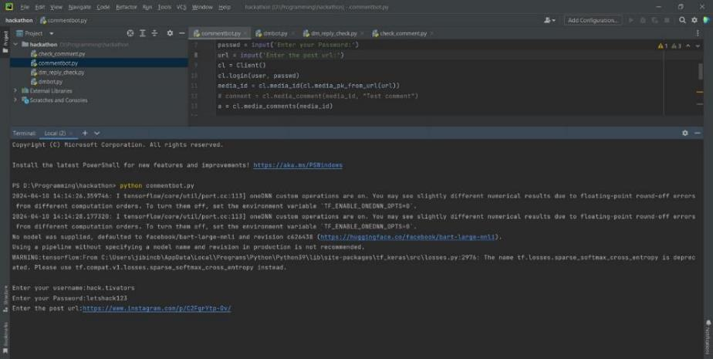
Project Demo
Comment Reply bot

Slide 12
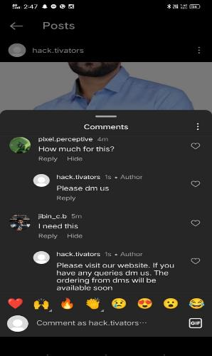
Project Demo
Comment Reply bot

Slide 13
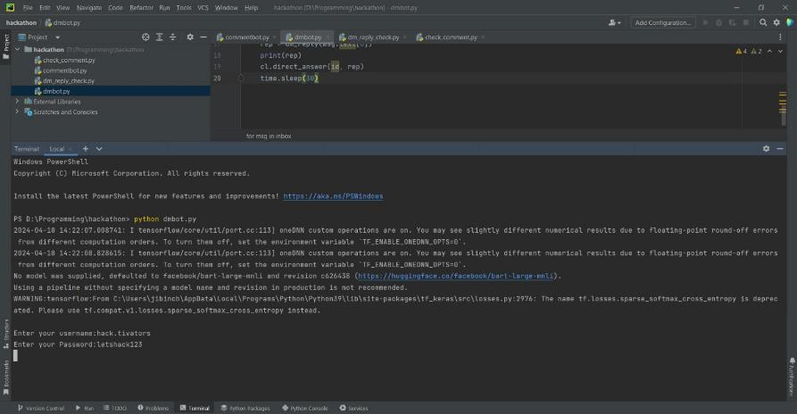
Project Demo
Direct Message Reply bot

Slide 14
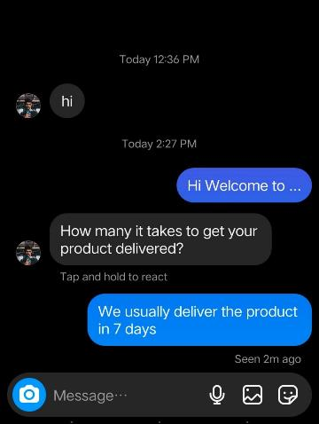
Project Demo
Direct Message Reply bot

